Slide 1
Date: August 21, 2020
Class XII
Subject: BIOLOGY
Topic: Outbreeding Devices
[Chapter 2 SEXUAL REPRODUCTION IN FLOWERING PLANT]

Slide 2
What would happen if continuous self pollination occurs in flowering plants?
Problem
↓ Answer: Occur inbreeding depression
(Reduction in fertility and productivity, characterised by reduced pollen production and decreased in quality and quality of seeds)
↓ Solution: Outbreeding Devices

Slide 3
Outbreeding Devices
Chapter 2 Sexual Reproduction In Flowering Plant

Slide 4
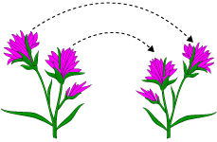
Outbreeding Devices
Outbreeding devices are mechanisms (adaptations/techniques/ways) to discourage self pollination and to encourage cross-pollination (for more genetic diversity).
These are barriers to self-pollination and depend on pollinators to transfer pollen.
Why do flowering plants opt for outbreeding devices though it is uneconomical?
Answer: Primarily for preventing inbreeding depression by avoiding self pollination and promoting cross pollination.

Slide 5
Dichogamy
Polenprepotency
Heterostyly
Outbreeding devices
Self-incompatibility
Unisexuality
Or
dicliny
Dioecy of plant
Notes:
If both male and female flowers are present on the same plant such as castor and maize (monoecious), it prevents autogamy but not geitonogamy.

Slide 6
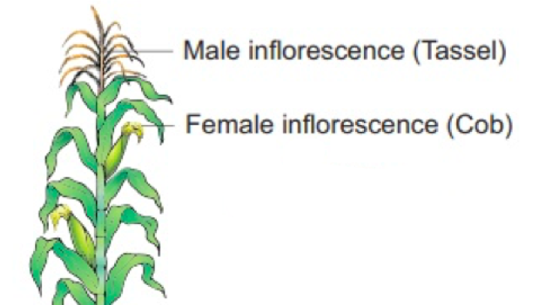
Some outbreeding devices to prevent self pollination/inbreeding
Dichogamy: Maturation of pollen and the ovary at different times i.e. pollen release and stigma receptivity are not synchronized.
Either the pollen is released before the stigma becomes receptive (protandry) or stigma becomes receptive much before the release of pollen (protogyny). Occurs in rose, sunflower,
Heterostyly: Anther and stigma are placed at different positions so that the pollen cannot come in contact with the stigma of the same flower.
Example; Primroses with two types of flowers (i) pin-eyed flower is long styled (i.e. has anthers positioned at the pollen tube’s halfway point) and the thrum-eyed has short styled (i.e. stigma is located at the halfway point).
Dicliny or Unisexuality of flower (Production of unisexual flowers): Growth of staminate flower (male flower) and pistillate flower (female flower) to prevent self pollination.
For example; both male and female flowers are present on the same plant such as castor and maize (monoecious), it prevents autogamy but not geitonogamy.
Pistillate flower
Staminate flower
Notes:
If both male and female flowers are present on the same plant such as castor and maize (monoecious), it prevents autogamy but not geitonogamy.

Slide 7
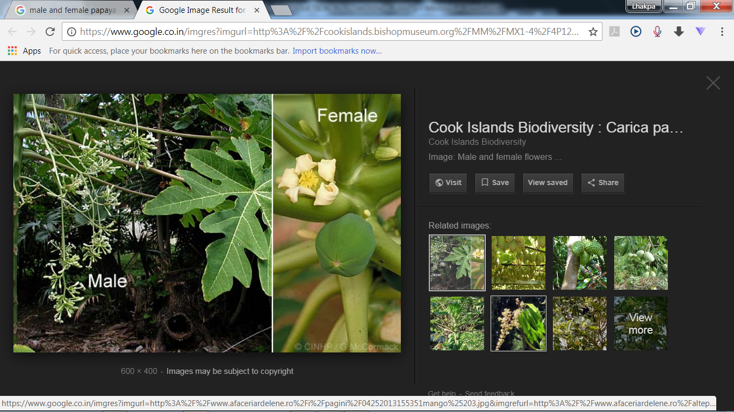
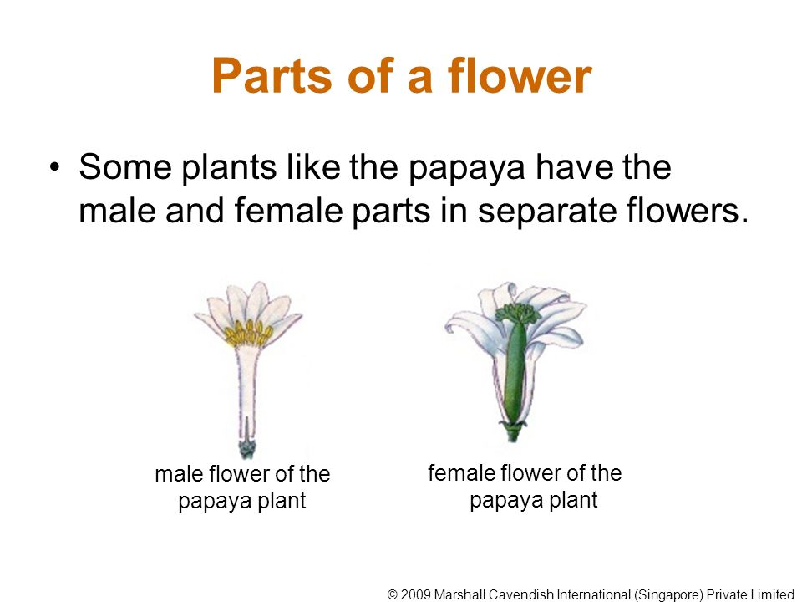
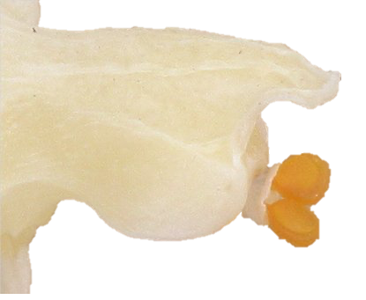
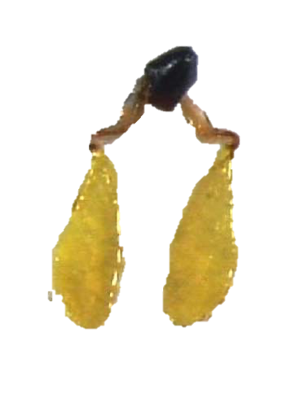
Some examples of outbreeding devices to prevent self pollination/inbreeding
Herkogamy: Natural physical barrier that prevent self pollen from entering self ovary. Pollens produced by orchids are protected together as pollinia (Cohesive masses of pollens).
Dioecy of plant: male and female flowers are grown on different plants.
Example: Papaya has male and female flowers, which are present on different plants i.e. each plant is either male or female
Self incompatibility: a genetic mechanism that prevents self pollen from fertilising the ovules by inhibiting pollen germination or pollen tube growth in the pistil.
S₃
S₄
S₁
S₂
S₁S₂
S₁S₂
Notes:
If both male and female flowers are present on the same plant such as castor and maize (monoecious), it prevents autogamy but not geitonogamy.

Slide 8
Some examples of outbreeding devices to prevent self pollination/inbreeding
Polenprepotency: In this mechanism the pollen of a different flower germinates faster than of the same flower thus preventing autogamy.
S₃
S₁S₂
Dichogamy
Polenprepotency
Heterostyly
S₁S₂
Outbreeding devices
Self-incompatibility
Dicliny
Dioecy of plant
Notes:
If both male and female flowers are present on the same plant such as castor and maize (monoecious), it prevents autogamy but not geitonogamy.

Slide 9
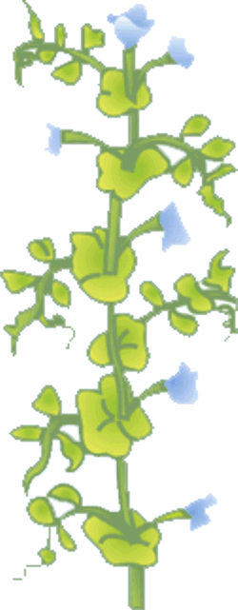

Artificial hybridization of plant
Artificial hybridisation is crossing between genetically dissimilar plants to produce a superior hybrid with superior genetic combination. i.e. crossing may be intervarietal, interspecific and intergeneric.
Main objective of artificial hybridization: To improve crop variety.
Artificial crossing experiments make sure that
only the desired pollen grains are used for pollination and
the stigma is protected from contamination (from unwanted pollen).
Artificial hybridisation is achieved by emasculation and bagging techniques.
High protein quality
Disease resistant
Hybrid
(with high protein quality and disease resistant
Notes:
purposeful manipulation of plant species in order to create desired plant types that are better suited for cultivation, give better yields and are disease resistant.

Slide 10
Artificial hybridisation in bisexual flower
Emasculation
Removal of immature anthers from the bisexual flower bud before the anther dehisces using forceps.
Bagging
Covering of emasculated flowers with a bag of suitable size, generally made up of butter paper, to prevent contamination of its stigma with unwanted pollen.
Re-bagging
As the stigma of bagged flower attains receptivity, desired mature pollen grains collected from anthers of the male parent are dusted on the stigma, and the flowers are rebagged, and the fruits allowed to develop.
Notes:
If both male and female flowers are present on the same plant such as castor and maize (monoecious), it prevents autogamy but not geitonogamy.

Slide 11
Artificial hybridisation in unisexual flowers
Emasculation is not needed for the female parent that produces unisexual flowers.
The female flower buds are bagged before the flowers open.
When the stigma becomes receptive, pollination is carried out using the desired pollen and the flower re-bagged.
Notes:
If both male and female flowers are present on the same plant such as castor and maize (monoecious), it prevents autogamy but not geitonogamy.

Slide 12
Answer the following questions
What are outbreeding devices?
Flowering plants opt for outbreeding devices though it is uneconomical. Give reason
Discuss at least five outbreeding devices with an examples each.
Explain artificial hybridization in bisexual plants.
How artificial hybridization in bisexual flowers is different from artificial hybridization in unisexual flower?
Mention the objectives of artificial hybridization.
Describe term emasculation with reference to artificial hybridization.
Notes:
If both male and female flowers are present on the same plant such as castor and maize (monoecious), it prevents autogamy but not geitonogamy.

